Slide 1


DATA PROGRAMMING
FINAL PROJECT – GROUP 3
200512570 – Sesha Sai Gopal
200512866 – Aswin Rajapandian
200523009 – Shefali Chaudhary

Slide 2



PROJECT TEAM
Shefali Chaudhary
Project Manager
Sesha Sai Gopal
Developer
Aswin Rajapandian
Analyst

Slide 3

COVID – 19 DATA
Source: https://rapidapi.com/axisbits-axisbits-default/api/covid-19-statistics/
The live cloud server data includes region wise data like number of confirmed cases, deaths, active cases, province etc. of United States of America

Slide 4
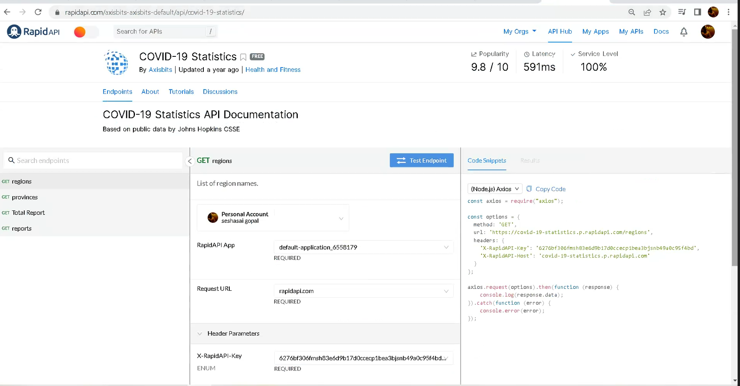
COVID – 19 STATISTICS API

Slide 5
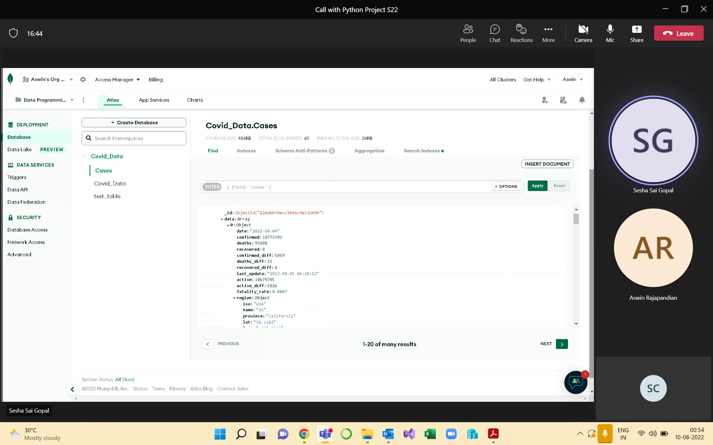
CLOUD DATABASE - MONGODB

Slide 6
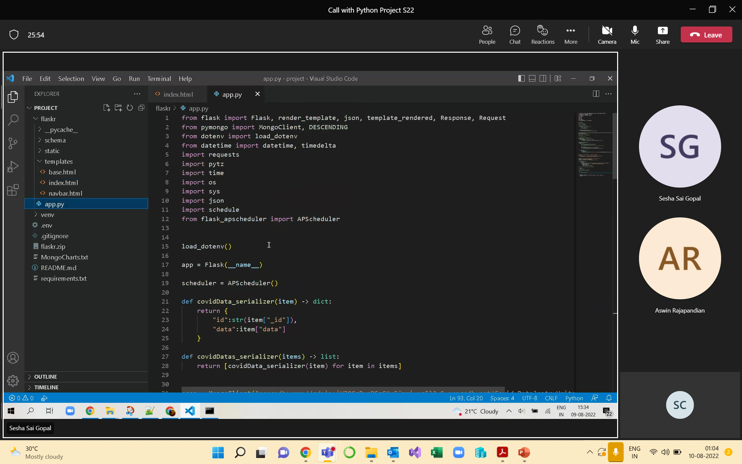
CODE SNIPET
https://github.com/SeshaSaiG/DataProgramming_FinalProject

Slide 7
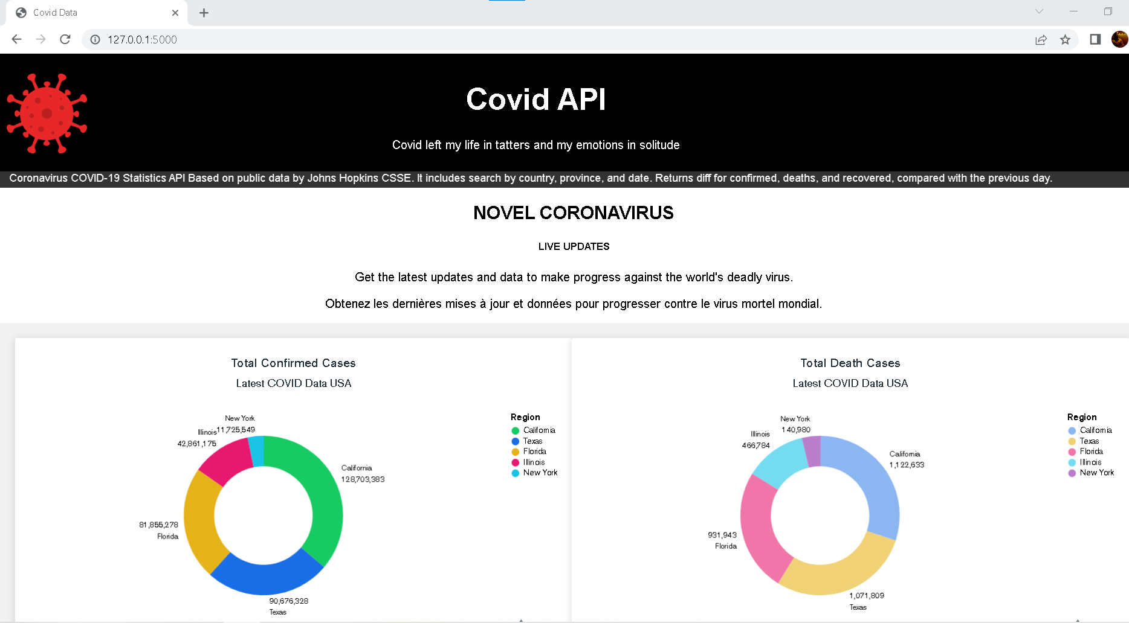
APPLICATION PAGE

Slide 8
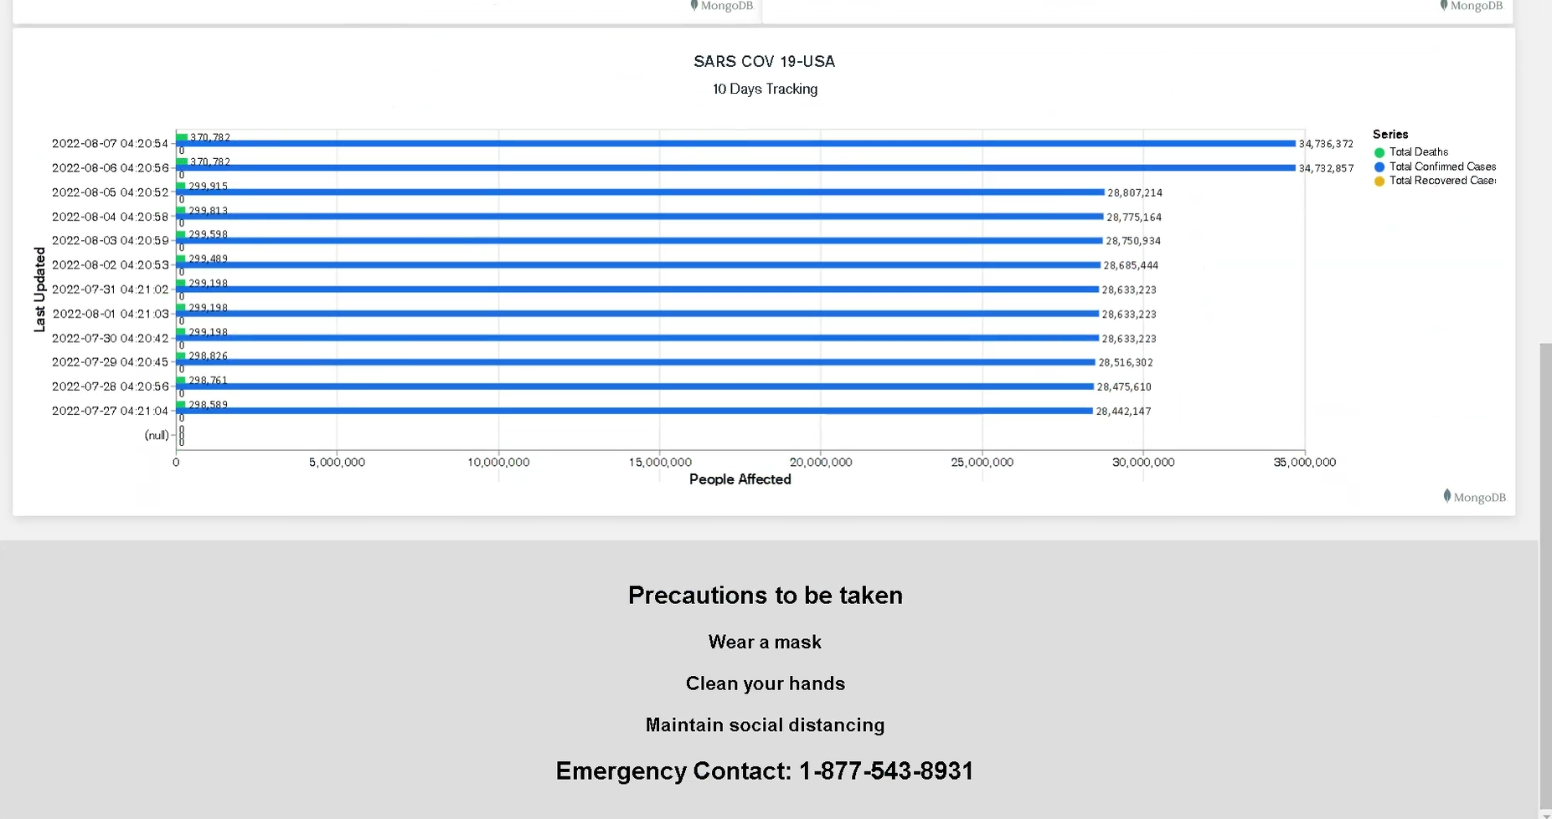
APPLICATION PAGE (in continuation)

Slide 9

DEMO
z

